Slide 1
Property Offences: Theft
Dr Kat Langley
Tuesday 14th January 2025

Slide 2
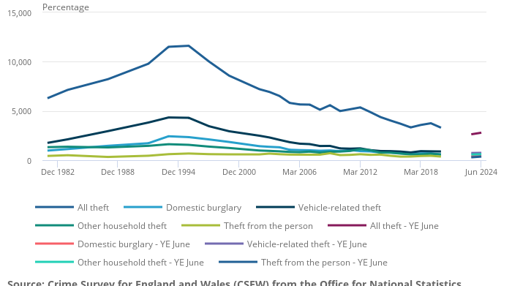
Theft Offences in England and Wales

Slide 3
Offence of Theft: Theft Act 1968
Section 1
A person is guilty of theft if he dishonestly appropriates property belonging to another with the intention of permanently depriving the other of it; and “thief” and “steal” shall be construed accordingly.
Actus reus
appropriation
property
belonging to another
Mens rea
intention permanently to deprive
dishonesty

Slide 4
Actus Reus
Appropriation
Property
Belonging to another

Slide 5
Appropriation (i)
In most cases, it sufficient to treat ‘appropriating’ as meaning ‘taking’
  The simplest example of appropriation is where D surreptitiously removes V’s wallet from their pocket
However, appropriation also has a very specific meaning:
  Theft Act 1968, Section 3:
      “Any assumption by a person of the rights of an owner amounts to an appropriation, and this includes, where he has come by the property (innocently or not) without stealing it, any later assumption of a right to it by keeping or dealing with it as owner.”
  This raises questions about when an appropriation occurs, what constitute the ‘rights of an owner’; whether absence of consent is an ingredient of the offence, and whether there can be an appropriation of indefeasible title to property

Slide 6
Appropriation (ii)
The ‘rights of an owner’
R v Morris, Anderton and Burnside [1984] AC 320 (HL)
  appropriation includes ‘any of the rights of owner’ (Lord Roskill)
R v Gomez [1992] AC 442 (HL)
When does an appropriation occur?
R v Gomez [1992] AC 442 (HL)
  When an individual assumes any of the rights of an owner
Atakpu [1994] QB 69
  ‘theft can occur in an instant by a single appropriation but it can also involve a course of dealing with property lasting longer and involving several appropriations before the transaction is complete’

Slide 7
Appropriation (iii)
Appropriation and consent
Lawrence v Metropolitan Police Commissioner [1972] AC 636 (HL)
  Whether the Theft Act should be construed as if it contained the words ‘without the consent of the owner’
  Consent is irrelevant to the offence of theft
R v Morris [1984] AC 320 (HL)
  ‘In the context of section 3(1), the concept of appropriation in my view involves not an act expressly or impliedly authorised the owner but an act by way of adverse interference with or usurpation of those rights.’
  No appropriation if the victim consented
R v Gomez [1992] AC 442 (HL)
  Confirmed the position in Lawrence
Appropriation of valid gifts
R v Hinks [2000] 2 AC 241 (HL)

Slide 8
Property
Theft Act 1968, section 4:
  ‘‘Property’ includes money and all other property, real or personal, including things in action and other intangible property.’
Limitations on:
theft of land: section 4(2)
theft of things growing wild: section 4(3)
theft of wild creatures: section 4(4)
Other things that do not constitute property:
Electricity: Low v Blease (1975) 119 Sol Jo 695
Confidential information: Oxford v Moss (1979) 68 Cr App R 183 (CA).
Corpses, though a corpse or other body parts (such as hair, blood, semen etc) can be property if reduced into another’s possession or control or if special skill has been exercised in relation to it: R v Kelly [1999] QB 621.

Slide 9
Belonging to another
Theft Act 1968, Section 5(1)
  ‘Property shall be regarded as belonging to any person having possession or control of it, or having in it any proprietary right or interest.’
Possession and control
R v Turner [1971] 55 Cr App R 336 (CA)
Proprietary right or interest
R v Marshall [1998] 2 Cr App R 282
Determined by reference to civil law principles which define ownership, possession, and equitable rights
Abandoned items
R (Ricketts) v Basildon Magistrates Court [2010] EWHC 2358

Slide 10
Mens Rea
Dishonesty
Intention permanently to deprive

Slide 11
Intention Permanently to Deprive
Section 6 of the Theft Act 1968
A person appropriating property belonging to another without meaning the other permanently to lose the thing itself is nevertheless to be regarded as having the intention of permanently depriving the other of it if his intention is to treat the thing as his own to dispose of regardless of the other’s rights; and a borrowing or lending of it may amount to so treating it if, but only if, the borrowing or lending is for a period and in circumstances making it equivalent to an outright taking or disposal.
Without prejudice to the generality of subsection (1) above, where a person, having possession or control (lawfully or not) of property belonging to another, parts with the property under a condition as to its return which he may not be able to perform, this (if done for purposes of his own and without the other’s authority) amounts to treating the property as his own to dispose of regardless of the other’s rights.

Slide 12
Thinking time….
Harry lives with Sam who has a season ticket for Hartlepool Utd. Previously, Sam has let Harry use the ticket for an earlier game which Sam could not attend.
Harry really wants to see the upcoming fixture, ad so whilst Sam is out, takes the season ticket to use that weekend.
Take a few minutes to discuss the issues arising in this short scenario.

Slide 13
Dishonesty
No definition of dishonesty in the Theft Act 1968
Section 2 sets out three circumstances in which the defendant will not be regarded as dishonest:
  Belief in the right to deprive
    (a) if he appropriates the property in the belief that he has in law the right to deprive the other of it, on behalf of himself or of a third person;
  Belief in consent
    (b) if he appropriates the property in the belief that he would have the other’s consent if the other knew of the appropriation and the circumstances of it; or
  Belief that the person to whom the property belongs cannot be discovered by taking reasonable steps
    (c) (except where the property came to him as trustee or personal representative) if he appropriates the property in the belief that the person to whom the property belongs cannot be discovered by taking reasonable steps.

Slide 14
Interpreting dishonesty (i)
R v Ghosh [1982] QB 1053 (CA)
  “a jury must first of all decide whether according to the ordinary standards of reasonable and honest people what was done was dishonest. If it was not dishonest by those standards, that is the end of the matter and the prosecution fails … If it was dishonest by those standards, then the jury must consider whether the defendant himself must have realised that what he was doing was by those standards dishonest.”
The ‘Ghosh Test’
Was D’s act dishonest according to ordinary standards of reasonable and honest behaviour? and
Did D believe himself to be dishonest according to those ordinary standards?

Slide 15
Interpreting dishonesty (ii)
Ivey v Genting Casinos UK Ltd (t/a Crockfords Club) [2017] UKSC 67
“When dishonesty is in question the fact-finding tribunal must first ascertain (subjectively) the actual state of the individual’s knowledge or belief as to the facts. The reasonableness or otherwise of his belief is a matter of evidence (often in practice determinative) going to whether he held the belief, but it is not an additional requirement that this belief must be reasonable; the question is whether it is genuinely held. When once his actual state of mind as to knowledge or belief as to facts is established, the question whether his conduct was honest or dishonest is to be determined by the fact-finder by applying the (objective) standards of ordinary decent people. There is no requirement that the defendant must appreciate that what he has done is, by those standards, dishonest.”

Slide 16
Interpreting dishonesty (iii)
The test reformulated in Ivey
What was D’s knowledge or belief as to the facts (a subjective test; the reasonableness of the belief is a matter of evidence of the belief being genuinely held)?
In light of the conclusion in relation to question (1), was D’s conduct honest or dishonest applying the (objective) standards of ordinary decent people?
DPP v Patterson [2018] 1 Cr. App. R. 28
  “it is difficult to imagine the Court of Appeal preferring Ghosh to Ivey in the future”
R v Barton and Booth [2020] EWCA Crim 575
Clarifies that the test for dishonesty is that set out in Ivey

Slide 17
Conclusions
5 steps to make out a Theft Offence.
Broad spectrum of Offences
LOTS of subjectivity.

